Slide 1
Chapter 16: Classes and Data Abstraction
Outline
16.6 Access Functions and Utility Functions
16.7 Initializing Class Objects: Constructors
16.8 Using Default Arguments with Constructors
16.9 Using Destructors
16.11 Using Data Members and Member Functions

Slide 2
Objectives
In this chapter, you will learn:
  To understand how to create, use, and destroy class objects.
  To be able to control access to object data members and member functions.

Slide 3
16.6 Access Functions and Utility Functions
Utility functions
  private functions that support the operation of public functions
  Not intended to be used directly by clients
Access functions
  public functions that read/display data or check conditions
  For a container, it could call the isEmpty function
Next
  Program to take in monthly sales and output the total
  Implementation not shown, only access functions

Slide 4
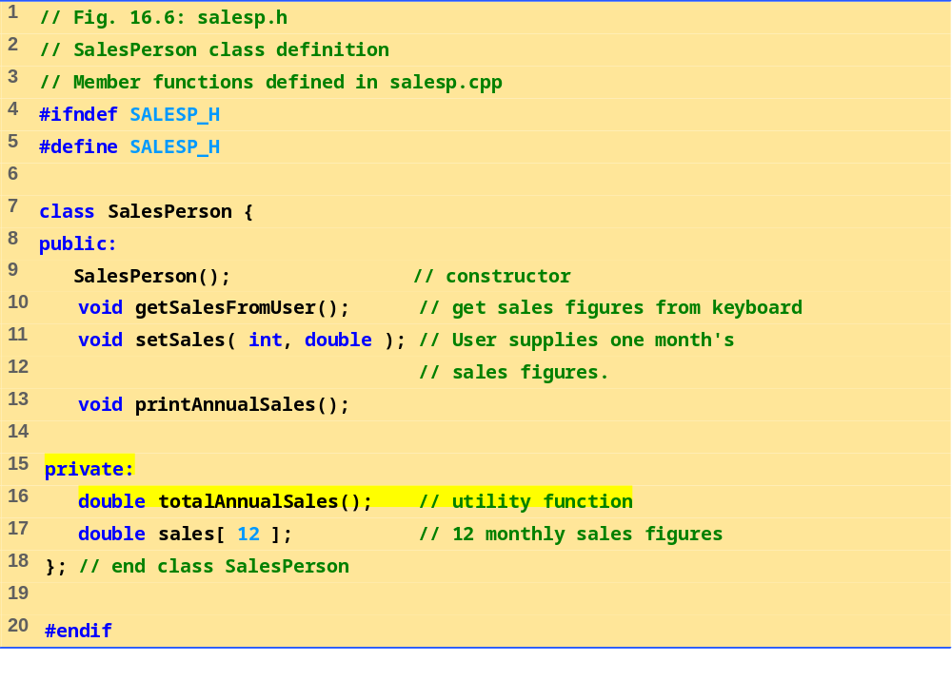
salesp.h

Slide 5
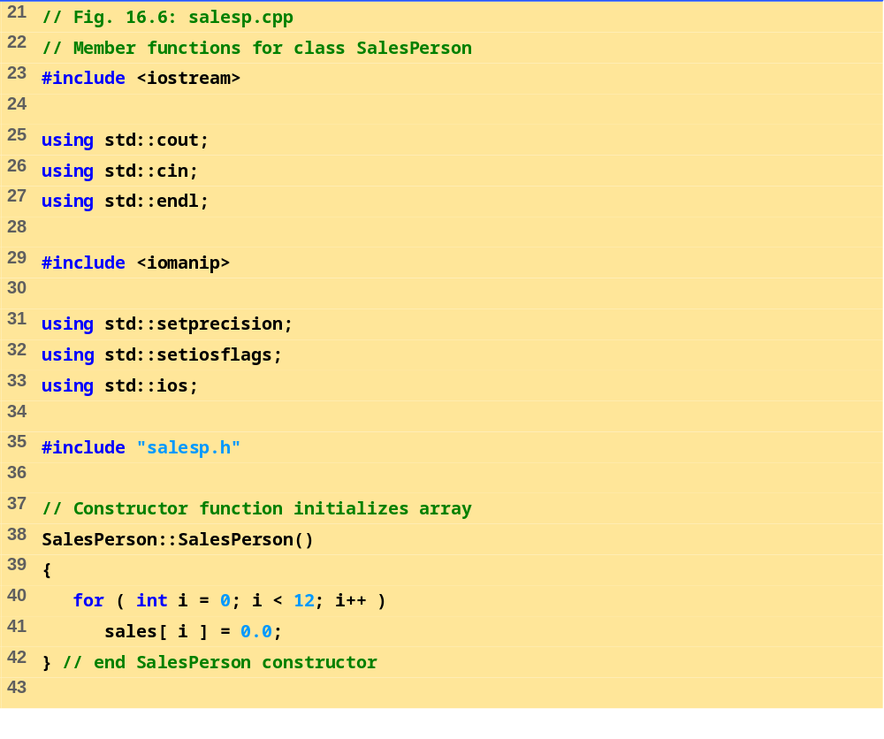
salesp.cpp (Part 1 of 3)

Slide 6
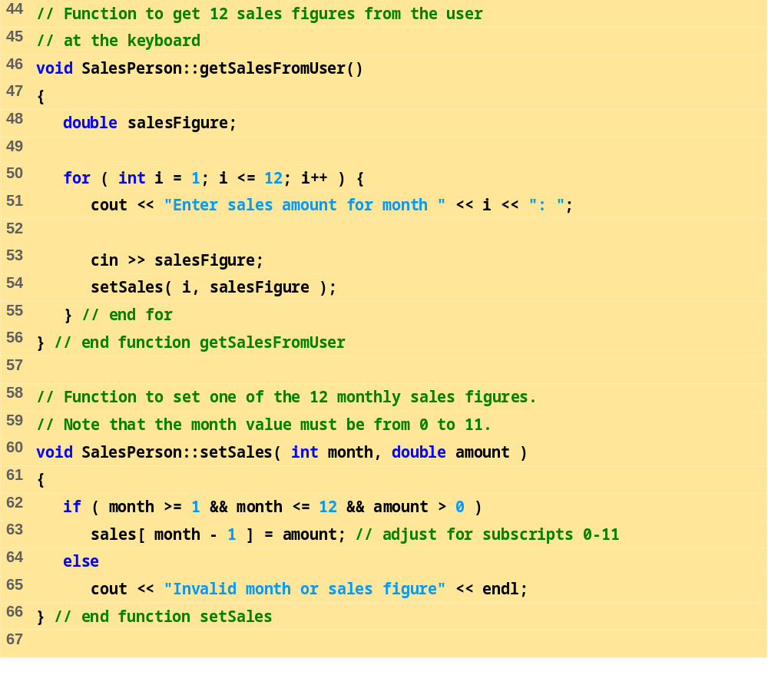
salesp.cpp (Part 2 of 3)

Slide 7
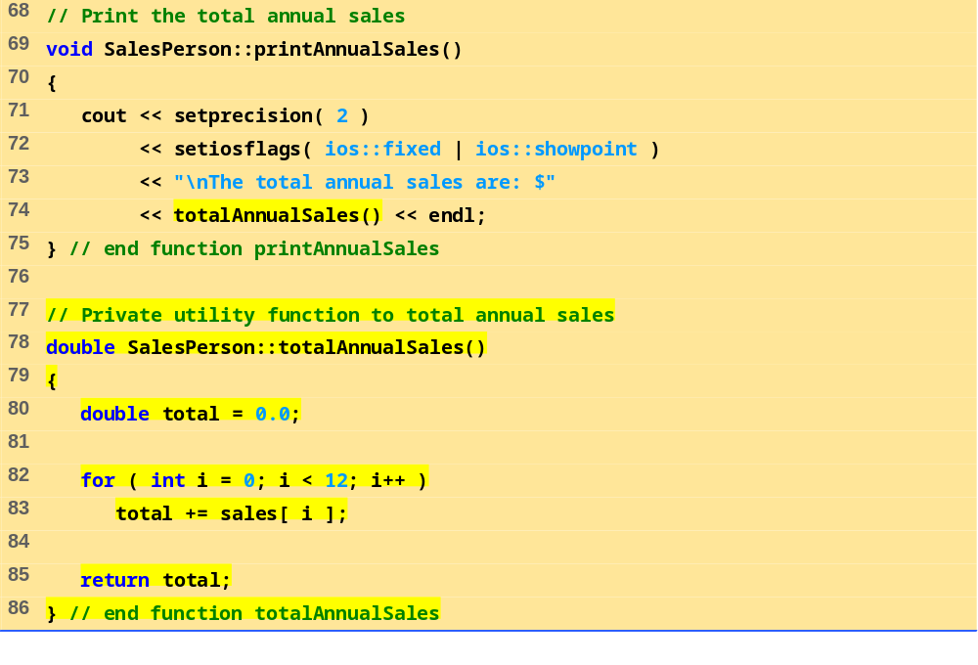
salesp.cpp (Part 3 of 3)

Slide 8
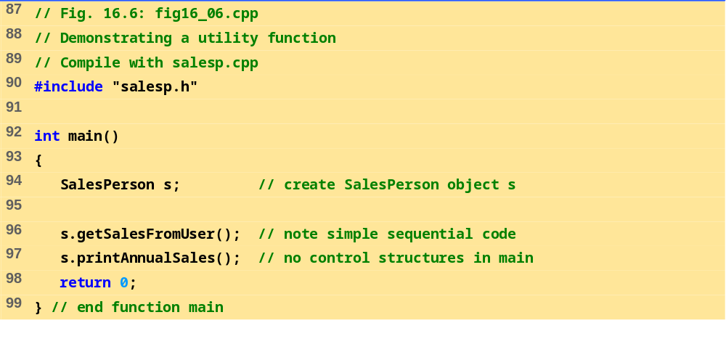
fig16_06.cpp
Program Output
Enter sales amount for month 1: 5314.76
Enter sales amount for month 2: 4292.38
Enter sales amount for month 3: 4589.83
Enter sales amount for month 4: 5534.03
Enter sales amount for month 5: 4376.34
Enter sales amount for month 6: 5698.45
Enter sales amount for month 7: 4439.22
Enter sales amount for month 8: 5893.57
Enter sales amount for month 9: 4909.67
Enter sales amount for month 10: 5123.45
Enter sales amount for month 11: 4024.97
Enter sales amount for month 12: 5923.92
The total annual sales are: $60120.59

Slide 9
16.7 Initializing Class Objects: Constructors
Constructor function
  Can initialize class members
  Same name as the class, no return type
  Member variables can be initialized by the constructor or set afterwards
Defining objects
  Initializers can be provided
  Initializers passed as arguments to the class’ constructor

Slide 10
16.7 Initializing Class Objects: Constructors (II)
Format
Type ObjectName( value1, value2, …);
  Constructor assigns value1, value2, etc. to its member variables
  If not enough values specified, rightmost parameters set to their default (specified by programmer)
  myClass myObject( 3, 4.0 );

Slide 11
16.8 Using Default Arguments with Constructors
Default constructor
  One per class
  Can be invoked without arguments
  Has default arguments
Default arguments
  Set in default constructor function prototype (in class definition)
    Do not set defaults in the function definition, outside of a class
  Example:
    SampleClass( int = 0, float = 0);
    Constructor has same name as class

Slide 12
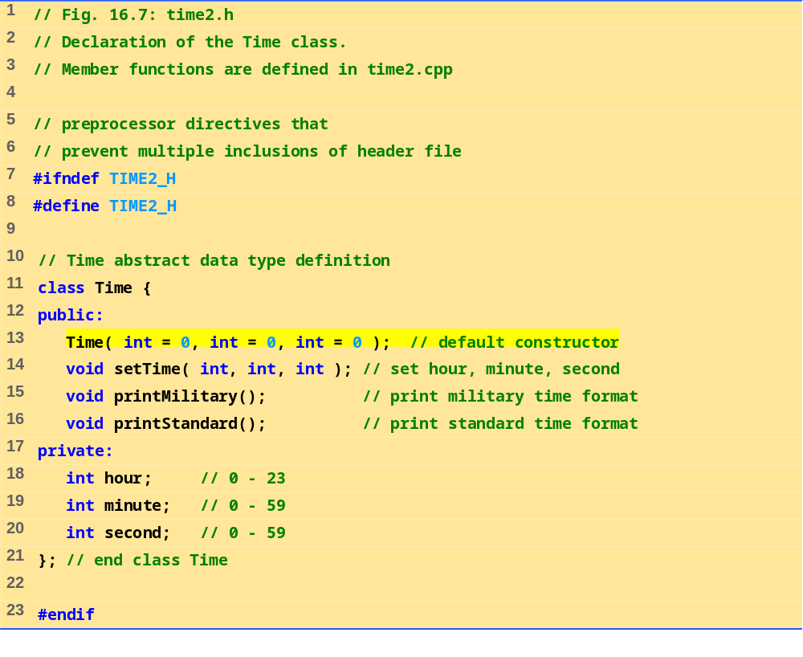
time2.h

Slide 13
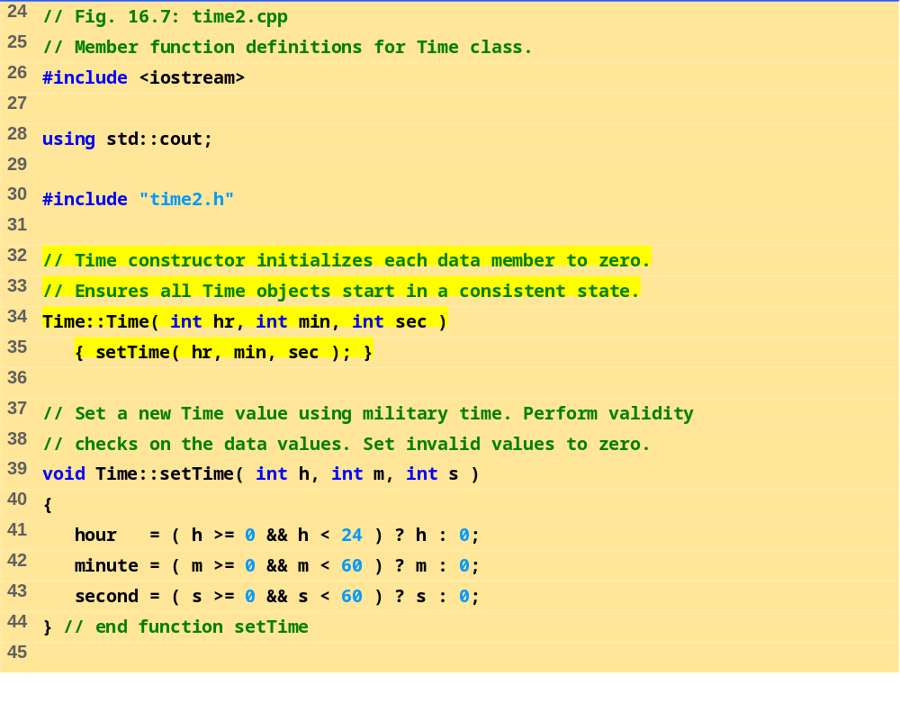
time2.cpp (Part 1 of 2)

Slide 14
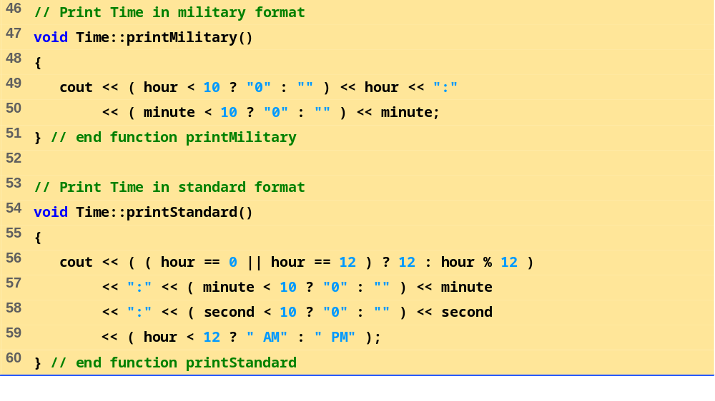
time2.cpp (Part 2 of 2)

Slide 15
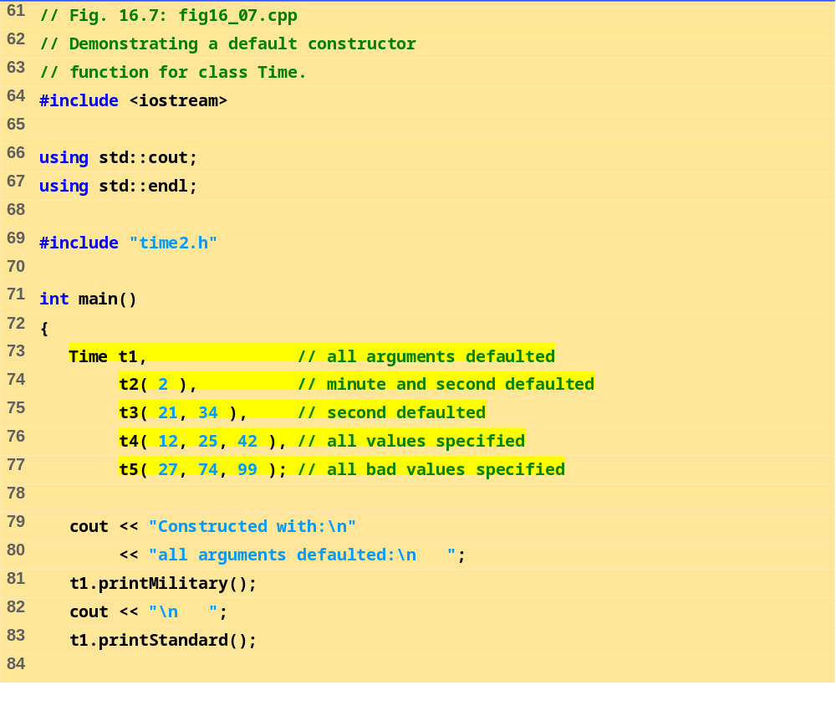
fig16_07.cpp (Part 1 of 2)

Slide 16
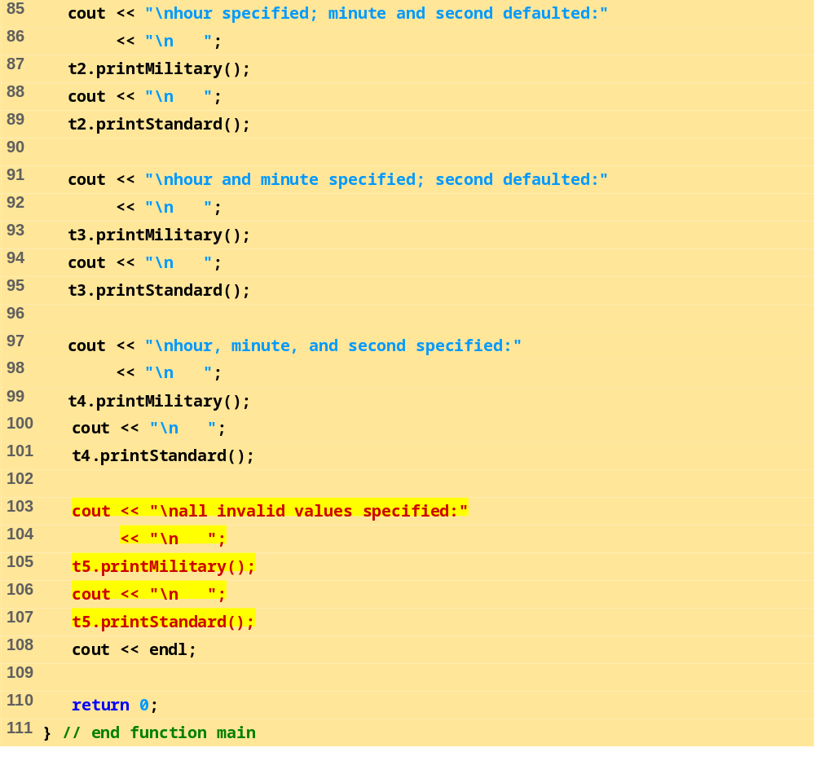
fig16_07.cpp (Part 2 of 2)

Slide 17
Program Output
Constructed with:
all arguments defaulted:
00:00
12:00:00 AM
hour specified; minute and second defaulted:
02:00
2:00:00 AM
hour and minute specified; second defaulted:
21:34
9:34:00 PM
hour, minute, and second specified:
12:25
12:25:42 PM
all invalid values specified:
00:00
12:00:00 AM

Slide 18
16.9 Using Destructors
Destructor
  Member function of class
  Performs termination housekeeping before the system reclaims the object’s memory
  Complement of the constructor
  Name is tilde (~) followed by the class name
    ~Time
    Recall that the constructor’s name is the class name
  Receives no parameters, returns no value
  One destructor per class - no overloading allowed

Slide 19
16.11 Using Data Members and Member Functions
Classes provide public member functions
  Set (i.e., write) or get (i.e., read) values of private data members
  Adjustment of bank balance (a private data member of class BankAccount) by member function computeInterest
Naming
  Member function that sets interestRate typically named setInterestRate
  Member function that gets interestRate would typically be called getInterestRate

Slide 20
16.11 Using Data Members and Member Functions (II)
Do set and get capabilities effectively make data members public?
  No!
  Programmer decides what the function can set and what information the function can get
public set functions should
  Check attempts to modify data members
  Ensure that the new value is appropriate for that data item
  Example: an attempt to set the day of the month to 37 would be rejected
  Programmer must include these features

Slide 21
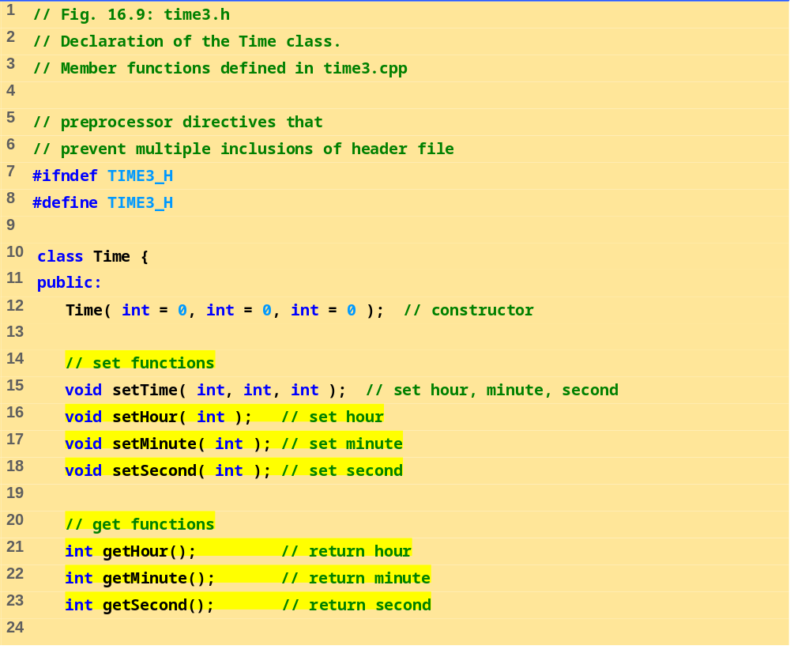
time3.h (Part 1 of 2)

Slide 22
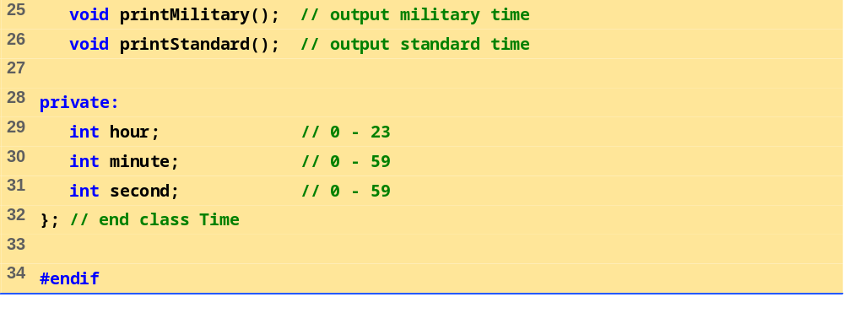
time3.h (Part 2 of 2)

Slide 23
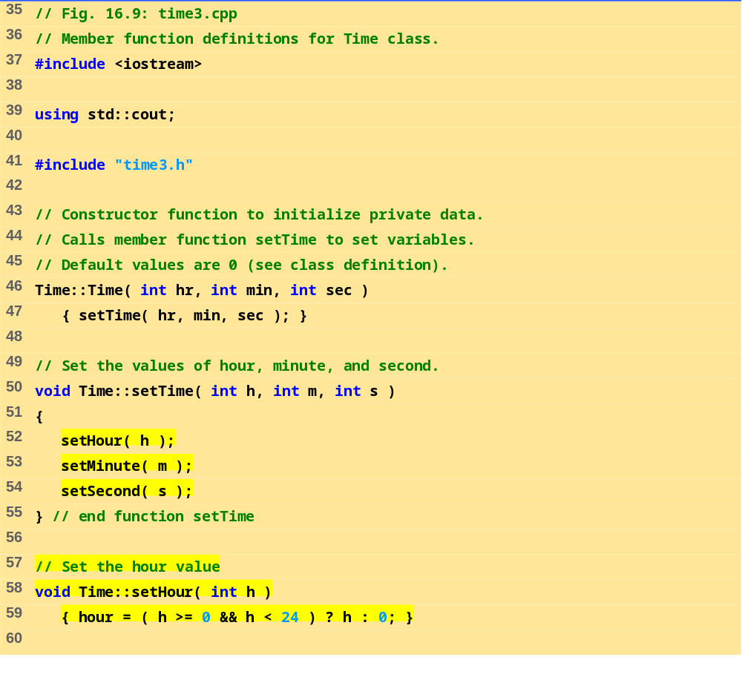
time3.cpp (Part 1 of 3)

Slide 24
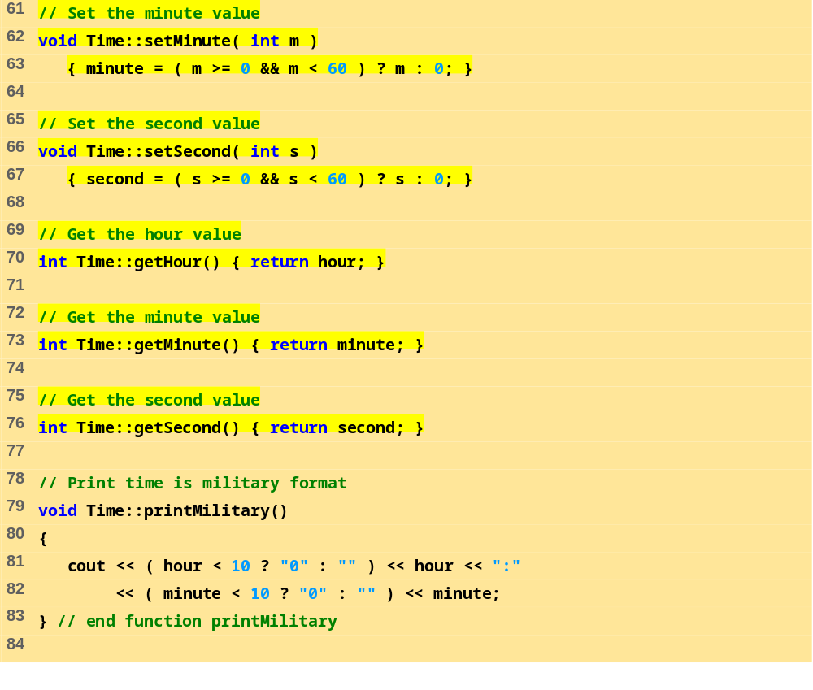
time3.cpp (Part 2 of 3)

Slide 25
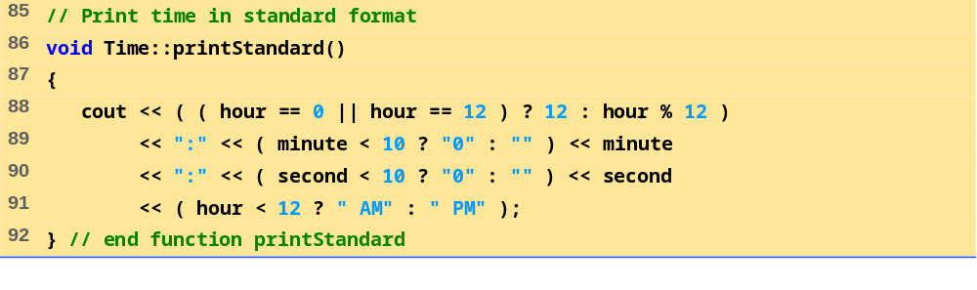
time3.cpp (Part 3 of 3)

Slide 26
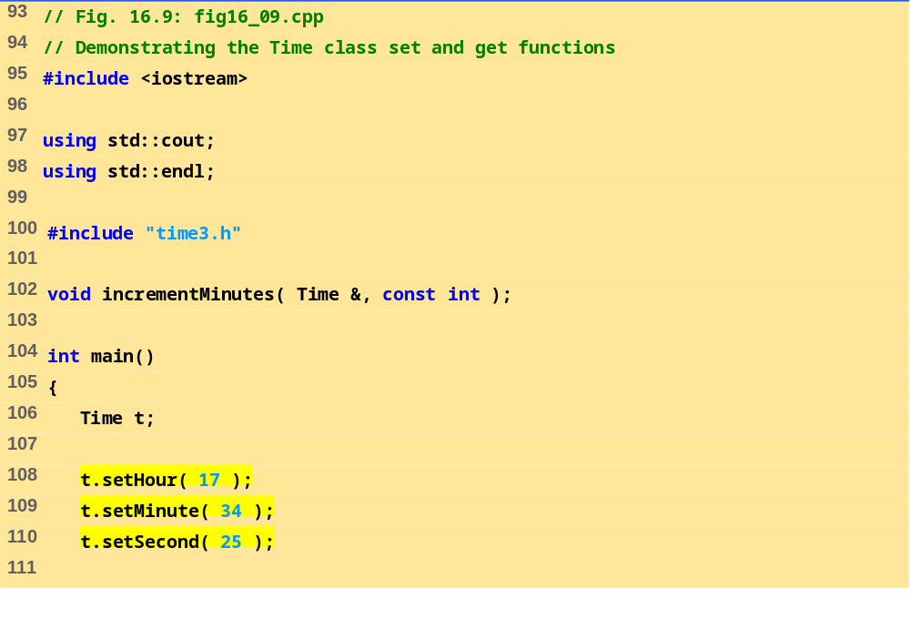
fig16_09.cpp (Part 1 of 3)

Slide 27
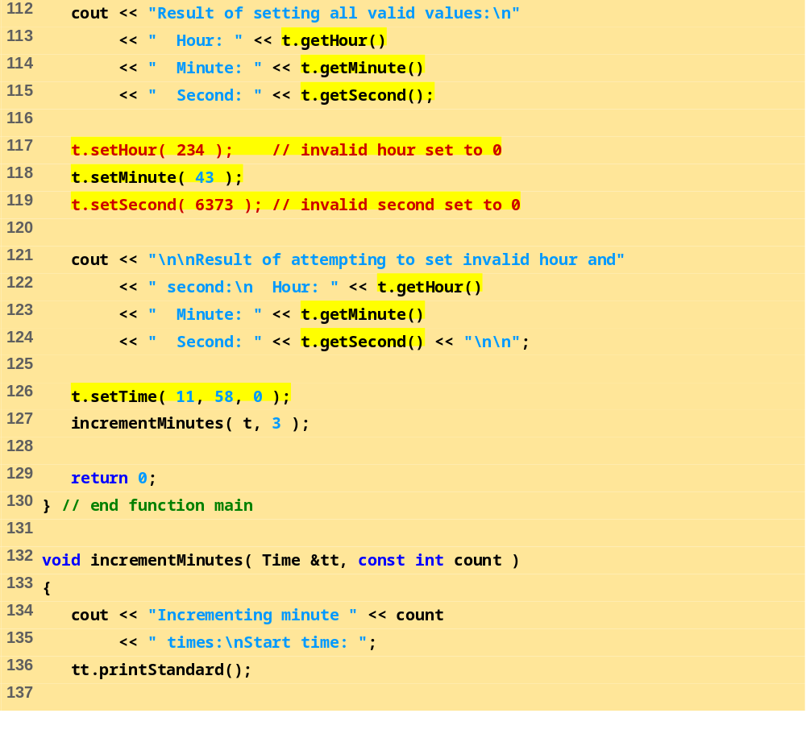
fig16_09.cpp (Part 2 of 3)

Slide 28
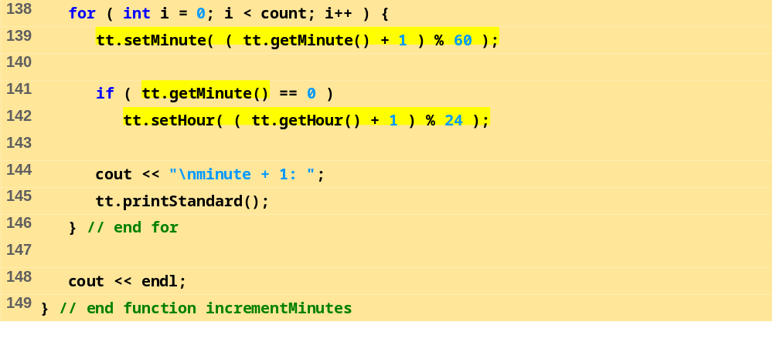
fig16_09.cpp (Part 3 of 3)
Program Output
Result of setting all valid values:
Hour: 17 Minute: 34 Second: 25
Result of attempting to set invalid hour and second:
Hour: 0 Minute: 43 Second: 0
Incrementing minute 3 times:
Start time: 11:58:00 AM
minute + 1: 11:59:00 AM
minute + 1: 12:00:00 PM
minute + 1: 12:01:00 PM

